Slide 1


Detecting comparisons between incompatible types

Slide 2
Introduction
Semantic analysis ensures the meaning of a program is correct
Type checking is a core responsibility of semantic analysis
Comparisons must obey strict type compatibility rules
Invalid comparisons are semantic errors, not syntax errors

Slide 3
Problem definition
Comparison operators require compatible operand types
Some data types cannot be meaningfully compared
Example errors:
array < int
pointer < integer
These errors must be detected before code generation

Slide 4
Comparison operators
Relational operators >,<,<=,>=
Equality operations ==,!=
Relational operators require ordered data types
Equality operators require compatible types

Slide 5
Type categories
Primitive type int, float, char, String,Double
Array type
Pointer type
Object/user-define

Slide 6
Invalid comparisons
array<int
array==array
pointer <non pointer
pointer == pointer

Slide 7
Important edge cases
Comparing arrays by value instead of address
Pointer compared with integer literal
Pointer vs pointer with different base types
Null pointer comparisons
Implicit type coercion hiding semantic errors

Slide 8
Attribute grammar approach
Each expression node has a type attribute
Types are synthesized bottom-up in the AST
Comparison node checks operand attributes
Semantic rules enforce type compatibility

Slide 9
Ast-based detection
Comparison node has two child expressions
Child nodes propagate their type information
Semantic analyzer inspects both operand types
Invalid combinations produce semantic errors

Slide 10
Semantic rules (formal)
Arrays cannot participate in comparisons
Relational operators require ordered scalar types
Pointer comparisons require compatible base types
Pointer and non-pointer comparisons are illegal

Slide 11
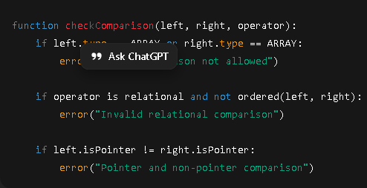
Pseudocode

Slide 12
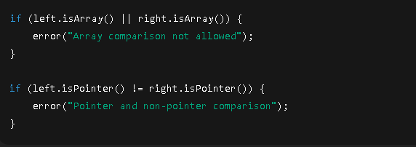
Java example

Slide 13
Error reporting
Messages should be clear and human-readable
Example:
Errors reported with line and column numbers
Cannot compare array ‘A’ with integer
Helps programmers quickly locate and fix errors

Slide 14
Role in compiler pipeline
Executed after syntax analysis
Prevents invalid intermediate code generation
Improves optimization correctness
Ensures safe and correct target code

Slide 15
CONCLUSION
Invalid comparisons are semantic-level errors
Arrays and pointers require special handling
Attribute grammars and ASTs simplify detection
Early detection improves compiler robustness

Slide 16
Thanks

